Slide 1

St. Andrew’s CE Primary School
Coffee Morning
Early Identification
&
Special Educational Needs (SEN)

Slide 2

Early Identification is a key factor in improving outcomes for children
Children’s brains are very flexible and intervention put in at a young age can benefit pupils at a neurological level and improve their life-long learning and achievement.

Slide 3

Section 6.14 of the SEN Code of Practice
‘All schools should have a clear approach to identifying and responding to SEN. The benefits of early identification are widely recognised – identifying need at the earliest point and then making effective provision improve long-term outcomes for the child or young person.’

Slide 4

Initial Concerns and Early identification in Early Years
Early Years Foundation Profile
The areas of learning are:
communication and language.
physical development.
personal, social and emotional development
literacy
mathematics.
understanding the world.
expressive arts and design
Development Matters
Oxfordshire’s Guidance for SEN Support

Slide 5

Early identification of literacy difficulties is vital.
Key risk factors for literacy difficulties are:
• Speech difficulties post 5 years
• Difficulty acquiring letter knowledge – both sounds and letter names
• Poor phoneme awareness and difficulty sounding out words for reading
• Poor ability to segment and manipulate phonemes for spelling

Slide 6

If a child’s progress in any prime area gives cause for concern, the Class Teacher will...
consider the child’s date of birth
discuss this with the child’s parents / carers and agree how to support the child.
consider whether a child may have a Special Educational Need (SEN) or disability which requires specialist support.
link with and help families to access relevant services from other agencies as appropriate

Slide 7

St. Andrew's CE Primary School employs a holistic approach...
All the information is brought together and considered with the child’s parents/carers. This includes information about:
The child’s learning and development, within and beyond the setting;
Teacher & TA observations, formal checks, any other detailed assessment, any specialist advice;
Progress in the prime areas: communication and language, physical development, social and emotional development.

Slide 8

Parents know their children best ......
Discussions with parents can give Teachers insights into a child’s personality, feelings or interests . There may be changes in a child’s life which parents may not have mentioned, perhaps because they did not feel that they were important or because they are very personal, e.g:
Illness or bereavement in the family
Parents separating
A change of carer or child-minder
Living in temporary or unsuitable accommodation
The child’s disturbed sleeping pattern
A new baby

Slide 9

Voice of the Child
Young children may express their wishes, views and feelings for themselves in a range of ways.
Practitioners can support interactions and dialogue with children by using visual prompts and photos to get them to show what they like doing and what they find difficult.
Teachers can also understand children’s views by observing the choices they make: what they like to do and what they avoid.
Teacher & TA observations are a purposeful part of everyday practice and it may be these that will initially alert practitioners to a delay in a particular area.

Slide 10
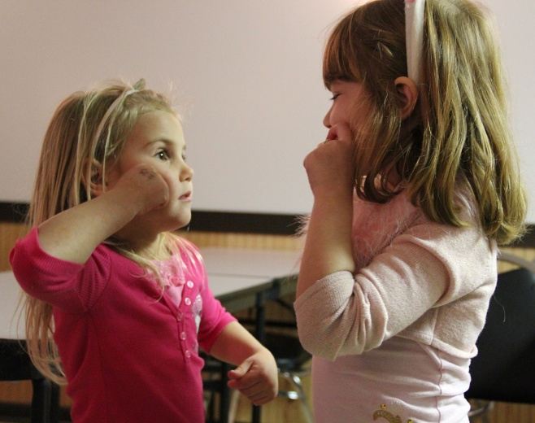
Language development is accepted as being critical to learning, cognitive development and literacy...
It is expected that when a child starts primary school, they will be able to understand much of what is said, express themselves clearly, share their feelings and make their needs known.
A child who struggles to speak will often struggle to read and write, (can be compounded if children are taught to read and write before their spoken language skills are developed enough) to access this teaching.
Children with SLCN can become withdrawn or present with challenging behaviour .
Pupils are screened with BPVS.

Slide 11

Intervention is put in place to prevent pupils falling behind ...
Talk Boost
Spirals

Slide 12
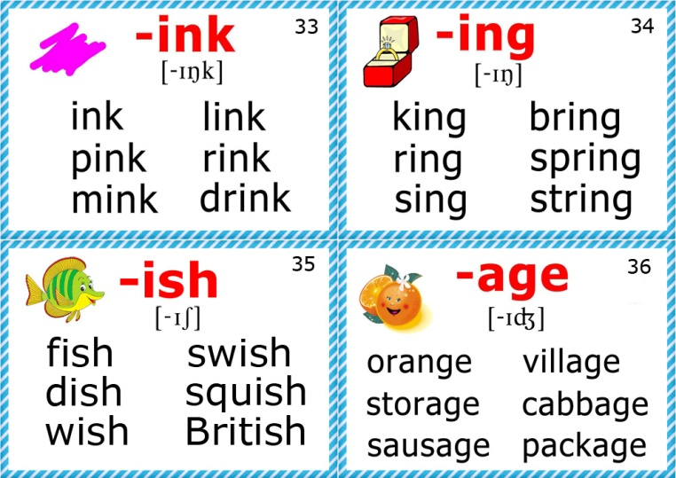
Daily Story Reading of Picture Books in Reception & Key Stage 1. Monitoring of Pupils Reading Progress.
‘Read, Write, Inc.’ grids and Dolch Sight Vocabulary ( 220 words make up approximately 70 % of all reading matter, allowing children to develop fluency in reading.)
Reading Diary which accompanies home reading books.
Supporting Pupils with Phonics.
Regular assessments ,culminating in the national Year 1 Phonics Screening Test. Children scoring below the national bench mark will be identified & supported through intervention in Year2 and re-tested at the end of Year 2.
Further assessments -Literacy Assessment Pack (LAPack) or Phonological Assessment Battery (PhAB).
Launch Into Reading Success

Slide 13

Multi-sensory Precision Teaching
Reading Eggs,
Read, Write, Inc
Project X Code
Fischer Family Trust Wave 3
Children who are struggling to learn to read will take home ‘Read, Write, Inc. decodable books’. Parents and carers will be invited to meet with the class teacher and/or SENCo to discuss how they can give increased home support to their child as well as the child being read with every day at school.
In some circumstances it might be felt that a phonics approach to learning to read is unsuccessful for a child. In which case the SENCo, Class Teacher and parents/ carers will meet to discuss the best way forward to support learning, and other approaches will be explored.
(Early Intervention) SEN Pupil Trackers are used to monitor progress & are shared with the parents termly.

Slide 14
Thank you for listening!
Any Questions?

