Slide 1
Dyspraxia
Developmental co ordination Disorder
Notes:
Mention that these labels are often used in an interchangeable way. We are not diagnosticians and the talk does not enable people to diagnosis but to recognise when a child is struggling. DCD is an umbrella term for all coordination difficulties.

Slide 2
Definition
Dyspraxia, a form of developmental coordination disorder (DCD) is a common disorder affecting fine and/or gross motor coordination, in children and adults. While DCD is often regarded as an umbrella term to cover motor coordination difficulties, dyspraxia refers to those people who have additional problems planning, organising and carrying out movements in the right order in everyday situations. Dyspraxia can also affect articulation and speech, perception and thought (Dyspraxia Foundation, 2013).
Although Dyspraxia may occur in isolation, it frequently coexists with other conditions such as Attention Deficit (Hyperactive)Disorder (ADD/ADHD), Dyslexia, language disorders and social, emotional and behavioural impairments.
Notes:
Here you can unpick the definition if you want and talk about the different areas and how they impact.

Slide 3
Prevalence
The condition is thought to affect at least 5% of the population in varying degrees (Lingham R et al). It is probable that there is at least one child with dyspraxia in every classroom requiring access to a specific treatment programme.
It often co exists with another specific learning difficulty but can also be separate and unique.
Notes:
Underline that it is really not rare and people will be struggling.

Slide 4
Important to remember
Children whose dyspraxia is identified at an early stage are less likely to have problems with acceptance by their peers and with lowered self-esteem.
Early recognition really can make the difference between success and failure.
It is a life long condition.
Notes:
With teachers you can really emphasise the ability they have to make or break these children. A great opportunity to allow them to reflect on the huge responsibility they have.

Slide 5
Liam…..
http://www.youtube.com/watch?v=6Oe_qPcTnz0
https://www.youtube.com/watch?v=9ZjQILd5esk
Notes:
Liam is a great young ambassador. This also introduces the work of the Foundation too. Will need internet access to view dso delete if this is not available or ask the audience to take a look on you tube.

Slide 6
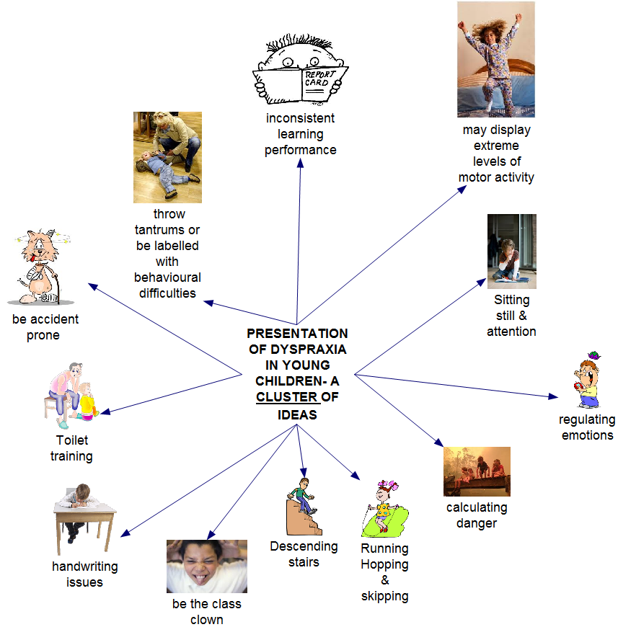
Presentation of Dyspraxia/
DCD in a child.

Slide 7
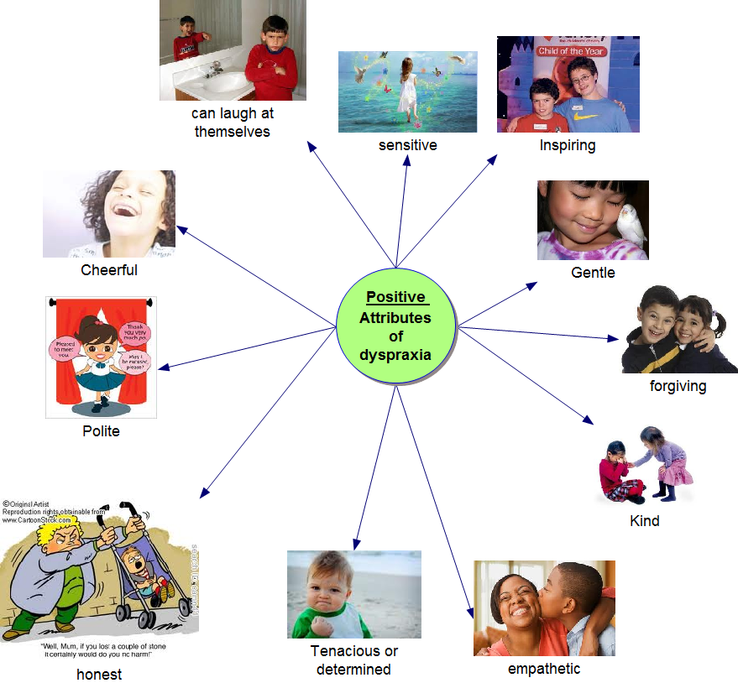
Positive attributes of Dyspraxia/DCD.

Slide 8
Poor posture, body awareness and awkward movements
Difficulties at School
Confusion over laterality with the pupil interchanging between left and right hand for different tasks
Poor short term visual and verbal memory - copying from the board, dictation, following instructions
Writing difficulties both with style and speed - frequently children have an awkward pen grip
Poorly developed organisational skills and difficulty with planning written work
Difficulties with physical activities such as in P.E. with the child having difficulty with eye hand and eye foot co-ordination (i.e. ball skills), running or using equipment easily

Slide 9
Teenagers
When children become teenagers their problems may change as social and organisational difficulties become more pressing.
Deal with the predominate issue.
The Dyspraxia Foundation can help and support children & families through its services and publications.
Notes:
Here we could offer one set for primary and one for pre school age children too and suggest the DF handouts to be distributed at this time.

Slide 10
Remember….
Activities which involve well developed sequencing ability or speed of processing are difficult
Problems with awareness of time, pupils need constant reminders
Often have poor exercise tolerance, tire easily and may require longer periods of rest and sleep
Some children may have phobias, obsessive or immature behaviour
Sensitive to external stimulation e.g. different levels of light, sound and heat intensity
Extremes of emotions, highly excitable at times and evidence of significant mood swings
Lack of awareness of potential danger, particularly relevant to practical and science
Often loners and have limited social development

Slide 11
How you can help….
Give the child as much encouragement as possible and make sure they are not made to feel a failure
Be aware of and acknowledge their difficulties and give strategies to reduce the frustration they experience particularly when required to complete written work
Break down activities and tasks into smaller components
Teach the child strategies in order to help them remember and organise themselves (e.g. use of diaries and lists)
Assist with short term verbal memory tasks by not giving too many words in dictation and asking the child to repeat instructions to you

Slide 12
Also…..
Help with short term visual memory by not expecting the child to be able to copy large blocks of text. Use strategies to help with copying from the board by using different colours per line or giving a ruler to copy text for each line. If demonstrating activities, break down the tasks into stages and give a few at a time
Allow the child to finish a task before moving on; they will feel a failure when work is consistently left incomplete
Allow them to snack (raisins or some high energy food stuffs) frequently.
Notes:
It is impossible to include everything and people will ask questions. If you don’t know the answer that is fine refer them to the DF.

Slide 13
Try…..
In P.E./games gain advice from the medical professionals and ensure that if the child is unable to join in a team game that he/she is given activities that will build up their particular abilities. Where possible allow the child alternatives from taking part in team games where the child will be identified as letting his/her side down
Ensure that where required assistance is given to the pupil to find his/her way around, they may forget where they are supposed to be
Allow access to word processors/lap tops/palm tops if they are available, - a voice processor with at least 80% accuracy can be invaluable

Slide 14
It is important to work with parents as they know their child better than anyone else
Ensure that there is good liaison with medical professionals
Be aware that during sudden growth spurts difficulties may manifest themselves to a greater extent
Encourage a close relationship with another child who can act as a guide/helper especially for the first few months following transfer to secondary school
Ensure that all instructions are always clear and precise. Make sure you explain yourself fully even if this means stating the obvious.
Notes:
Remember that this may be a family under pressure!!

Slide 15
P.E
Focus on the development of physical skills rather than on team sports. Young people with dyspraxia find it very difficult to plan their movements while at the same time responding to an ever-changing environment with lots of distractions.
Keep the environment as predictable as possible while teaching new skills.
Sports involving ball skills or the manipulation of objects are often more difficult for young people with dyspraxia. Provide opportunities for participation in alternative sport activities that will still help the young person to develop strength, stamina and physical fitness.

Slide 16
Also….
on-competitive
sports such as golf, climbing, rowing, cycling, martial arts, yoga and swimming are often more appropriate for young people with dyspraxia. They are also “life-style” sports that can be continued into adulthood.

Slide 17
The Dyspraxia Foundation AIMS…… http://www.dyspraxiafoundation.org.uk
To support individuals and families affected by dyspraxia.
To promote better diagnostic and treatment facilities for those who have dyspraxia.
To help professionals in health and education to assist those with Dyspraxia.
To promote awareness and understanding of dyspraxia.

Slide 18
PROVISION IN School
Our nurturing ethos!
Independent Learning Strategies
Lunch time clubs
Motor Skills Activity Folder
Teodorescu Perceptuo Motor Programme
Move to Learn
Start Write, Stay Right!
Speed Up!

Slide 19
Further SUPPORT…
http://www.dyspraxiafoundation.org.uk
Links to Oxford Dyspraxia group
http://psych.brookes.ac.uk/dcd/sessions.asp
http://www.movementmattersuk.org/
http://www.oxfordhealth.nhs.uk/children-and-young-people/oxon/integrated-therapies/occupational-therapy-2
Notes:
Have prices to hand and leaflets.

Slide 20
References
Lingam R, Hunt L, Golding J, Jongmans M, Emond A. Prevalence of Developmental Coordination Disorder Using the DSM-IV at 7 Years of Age: A UK Population-Based Study. Pediatrics 2009 123: e693-e700.

