Slide 1


Slide 2

Notes:
Clip 1 – introduction
https://www.youtube.com/watch?v=iJ8gX6UPYh4&feature=emb_logo

Slide 3
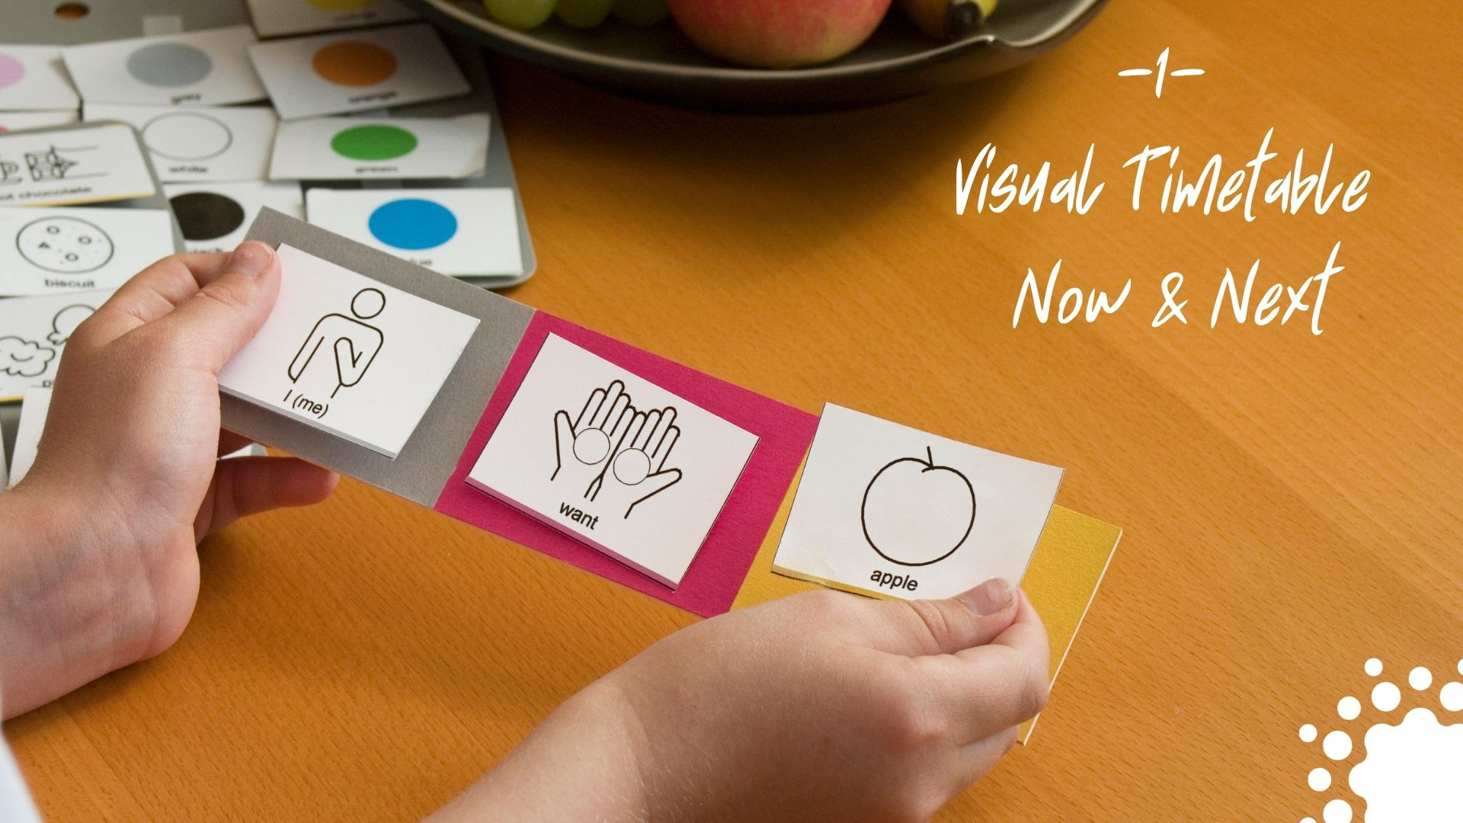

Slide 4
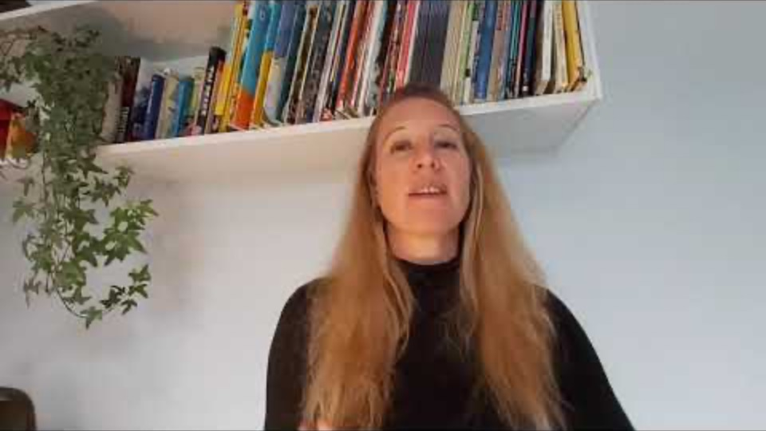
Notes:
clip 2 visual timetable
https://www.youtube.com/watch?v=skIk61mJ7VA&feature=emb_logo

Slide 5
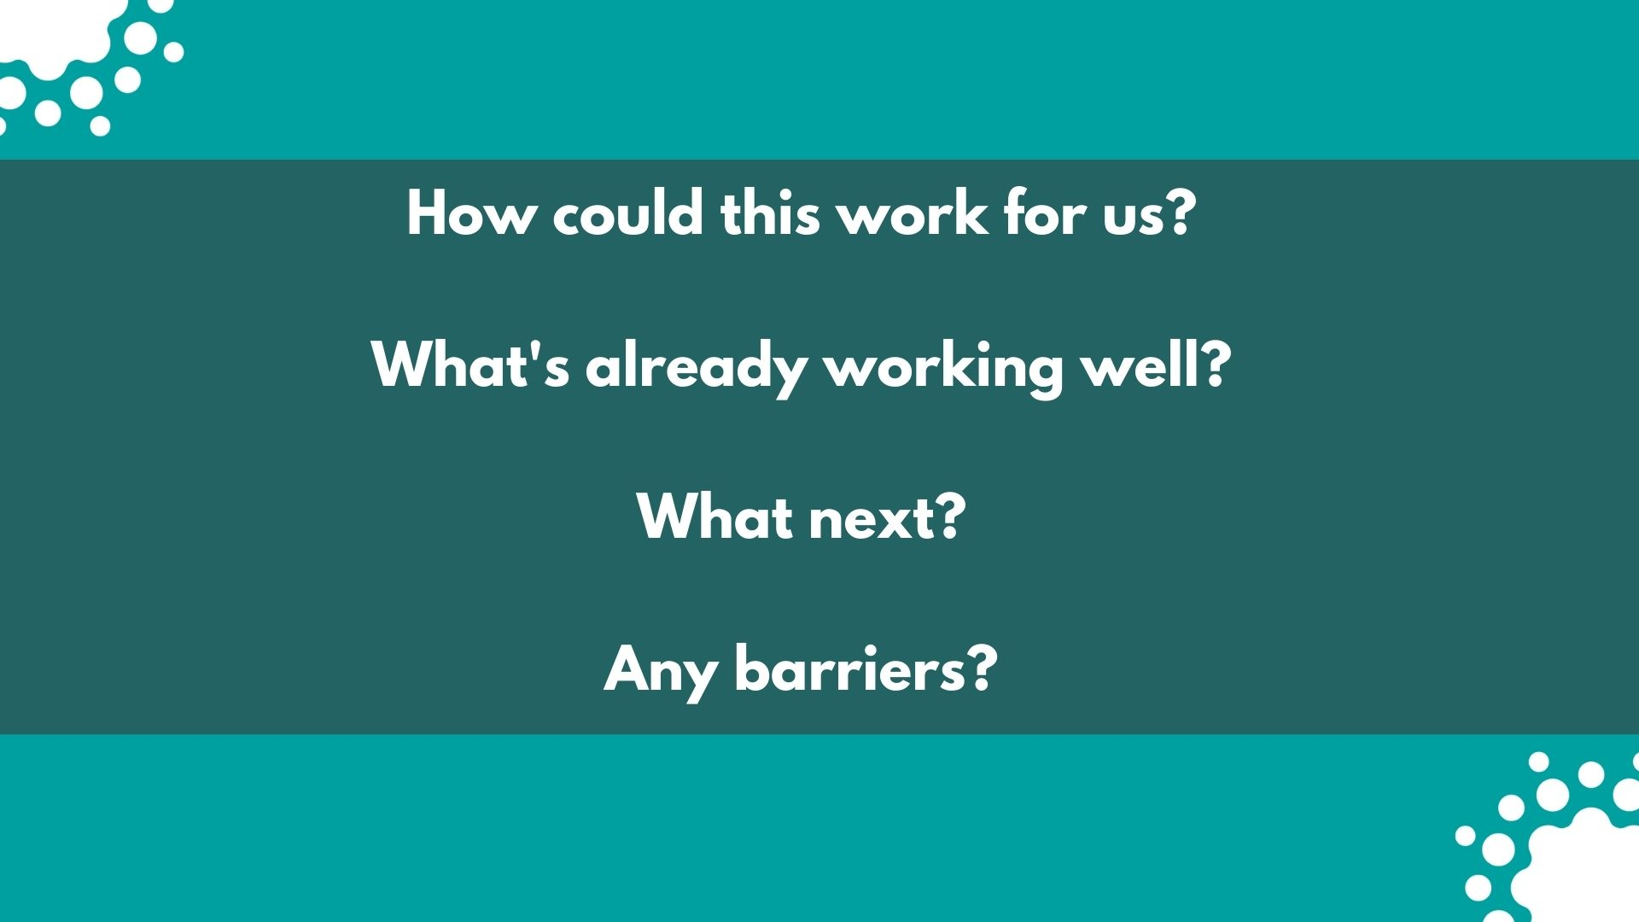

Slide 6
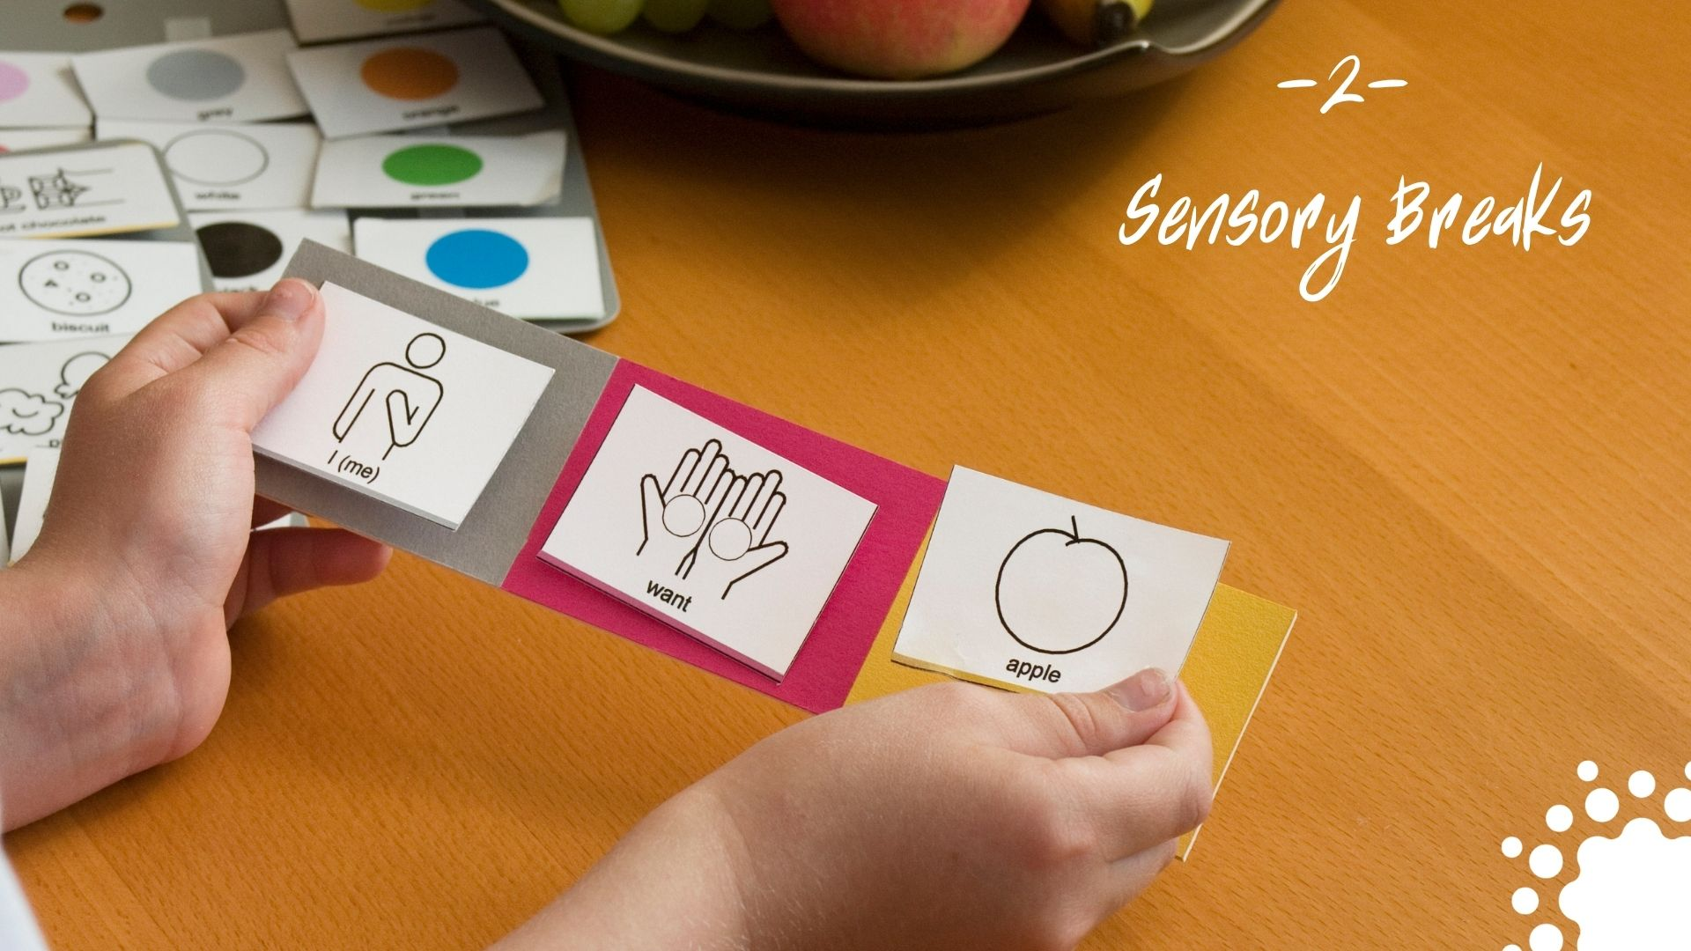

Slide 7

Notes:
clip 3 sensory breaks
https://www.youtube.com/watch?v=C9zTN9Y7X2U&feature=emb_logo

Slide 9


Slide 10

Notes:
clip 4 emotional safety
https://www.youtube.com/watch?v=6gOriocjvGo&feature=emb_logo

Slide 12


Slide 13

Notes:
clip 5 numeracy
https://www.youtube.com/watch?v=1toMw94ybBE&feature=emb_logo

Slide 15


Slide 16

Notes:
clip 6 literacy
https://www.youtube.com/watch?v=MrKijioBviI&feature=emb_logo

Slide 18


Slide 19


