Slide 1
A Parents’ Guide to the Zones of Regulation
https://www.youtube.com/watch?v=aQbs4JzdZH0

Slide 2
What do the Zones of Regulation Look like? – YouTube Helping students develop social, emotional & sensory regulation through using the Zones of Regulation…
Uses four colours to visually & verbally identify how they are functioning in the moment (emotionally & levels of alertness). Blue Green Yellow Red
Identify different emotions, sensory needs & thinking patterns that result in students moving from one zone to another
Toolbox: Explore & use a variety of tools , sensory supports, calming techniques & thinking strategies that they can use to regulate what zone they are in and how to move between them
Learn more about perspective taking to better understand how being in different zones impacts others’ thoughts & feelings around them
Increases vocabulary of emotional terms, skills in reading facial expressions, insights on events that trigger their behaviour & problem solving skills

Slide 3
Zones of Regulation Glossary-Using a common language
Self-regulation | Expected Behaviours
The Zones | Unexpected Behaviours
Blue Zone | What is the size of the problem? Is this a Big or a Little Problem?
Green Zone | Big Problem
Yellow Zone | Medium Problem
Red Zone | Little Problem
Toolbox | Inner critic
Tools or strategies | Inner Coach
Trigger | Superflex Thinking
Stop, Opt, and Go: | Rock Brain thinking
Notes:
p.14- Zones of Regulation Book

Slide 4
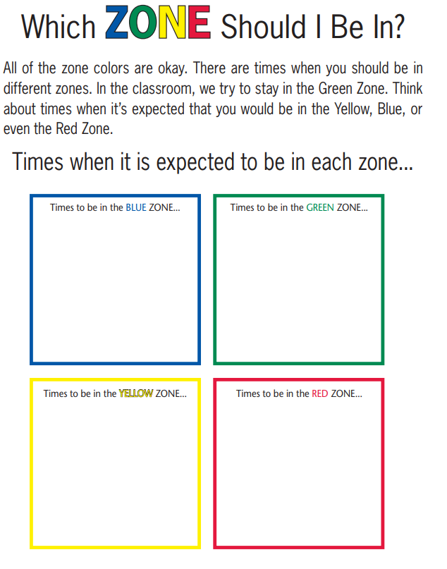

Slide 6
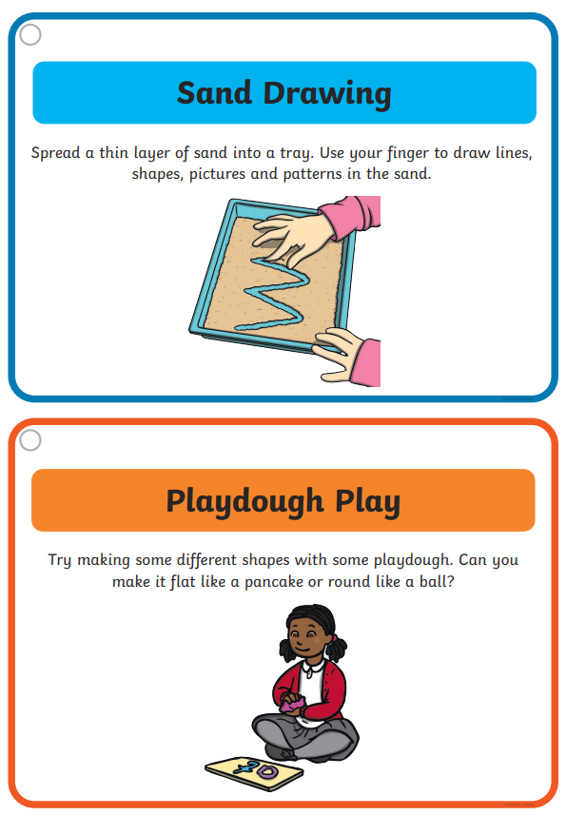
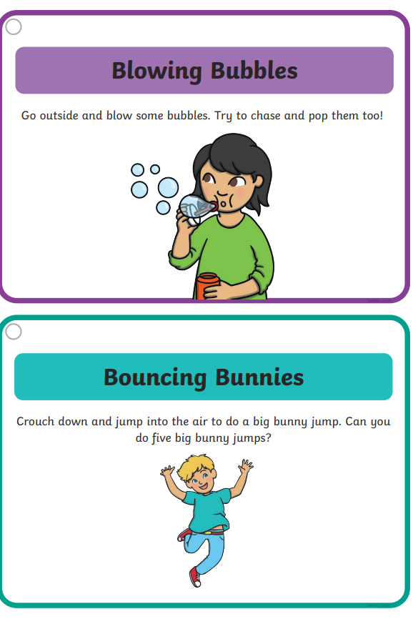
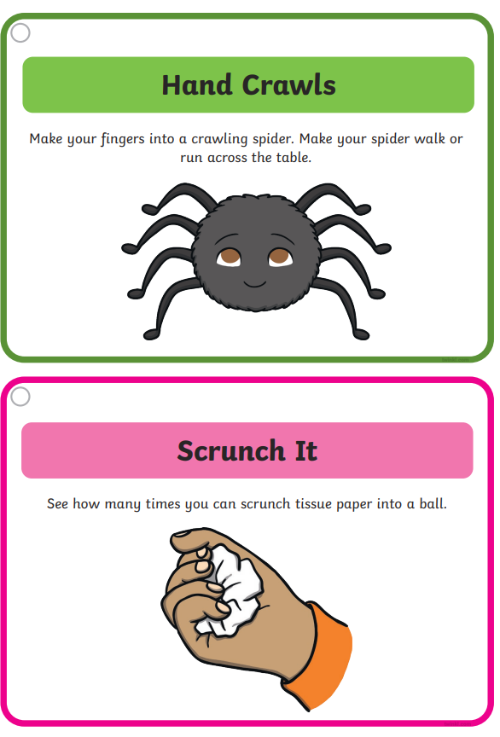

Slide 7
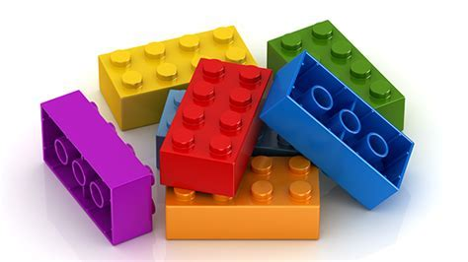
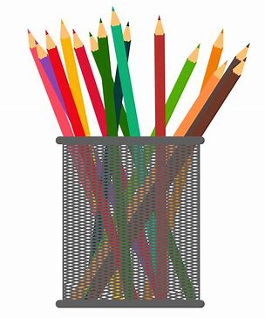
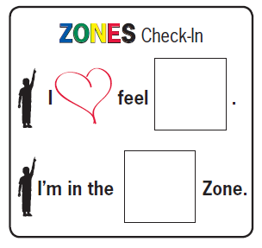
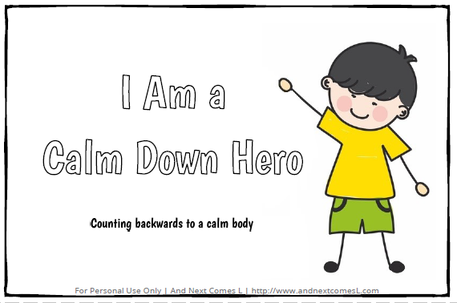
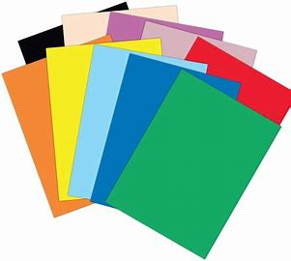
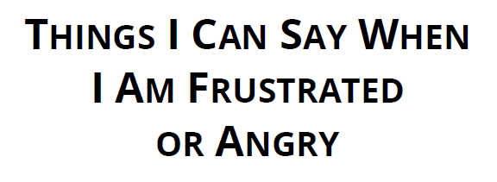
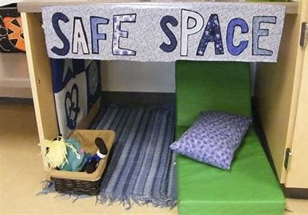
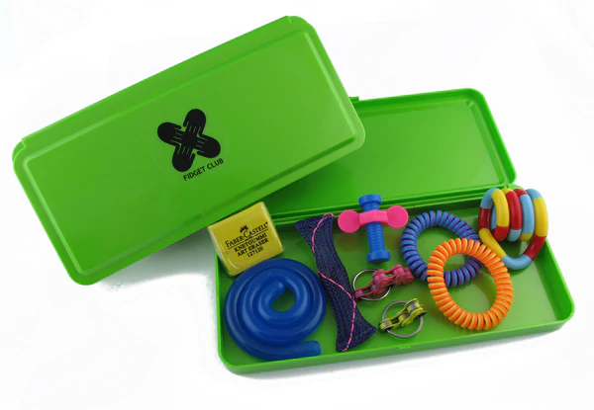
Talk to a friend
Talk to an adult
Lego time
Reward time
Keep going!
Drawing time
Zones Check In
Calm Down Rhyme
Frustrated Script
Star Breathing
Find a safe space
Stop
Keep Safe
Fidget Box
Quiet Time

Slide 8
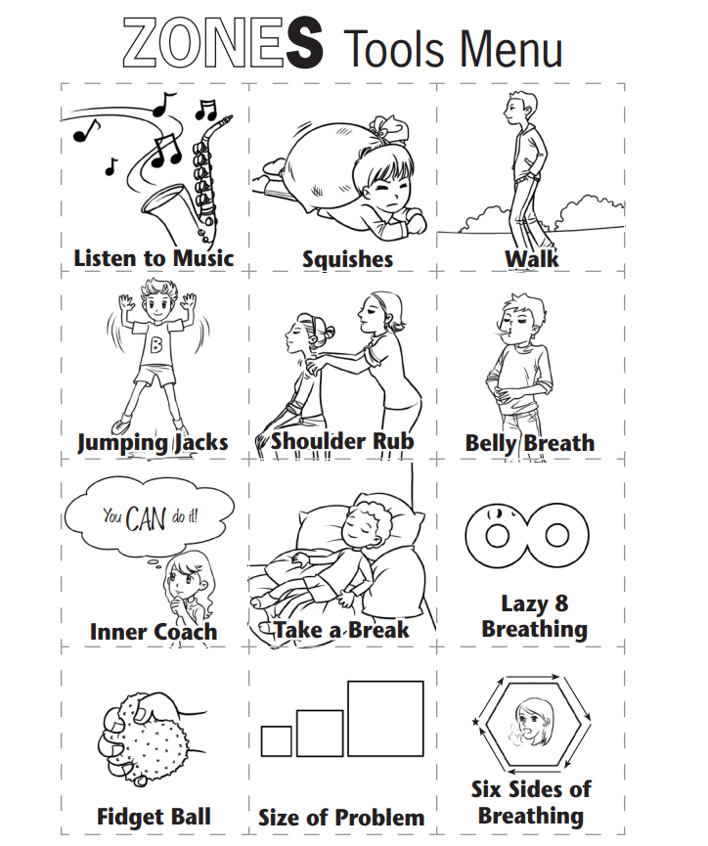

Slide 9
